Slide 1
SPS Test Beam Plan
Matt Hollingsworth

Slide 2
Main Phases
Configuration
Description
Amount of Data Needed
Get System Working
No B-Field
Alignment for strips
As many as necessary to get system under control
1)
Use the best plane as determined by 1)
Tilted to ~10 degrees
Alignment with PLT
2)
~100k events
Take data with B field to measure Lorentz smearing
Different field values: +3T, +2T, +1T, then -3T, -2T, -1T, finishing with 0T
200k at +- full
100k at +-1, +-2
200k at 0
3)
Same as 2)
Measure spatial resolution with charge sharing
4)
Same as 1)
1 million events

Slide 3
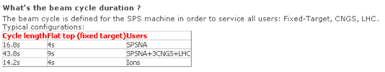
Expected Data Rates
Duty Cycle: 20%
Expect readout can handle at least 100 Hz (pessimistic)
90,000 events per hour
Full program as previously described lasts ~23 hours

Slide 4
Questions
B-field orientation? Max field (+ and -)? Ramp time?
Distance from counting room to setup?
Can we go in earlier to setup? If not in the beam line, can we go to the counting room?
Remaining paperwork? Safety inspection?

